Slide 1
Unit II Writing MapReduce Program
Prof. Kritika Purohit
Assistant Professor
Department of Computer Science & Engineering

Slide 2
Points to be covered
Map Reduce: Introduction , Architecture, Algorithm, Terminology
Phases of Map Reduce
Benefits and Applications of Map Reduce
Map Reduce Program for Weather Dataset

Slide 3
Introduction
MapReduce is a framework using which we can write applications to process huge amounts of data, in parallel, on large clusters of commodity hardware in a reliable manner.
MapReduce is a component of the Apache Hadoop ecosystem, a framework that enhances massive data processing.
A MapReduce job usually splits the input data-set into independent chunks which are processed by the map tasks in a completely parallel manner. The framework sorts the outputs of the maps, which are then input to the reduce tasks. Typically, both the input and the output of the job are stored in a file-system. The framework takes care of scheduling tasks, monitoring them and re-executes the failed tasks.

Slide 4
The MapReduce component enhances the processing of massive data using dispersed and parallel algorithms in the Hadoop ecosystem. This programming model is applied in social platforms and e-commerce to analyze huge data collected from online users.
MapReduce is a processing technique and a program model for distributed computing based on java. The MapReduce algorithm contains two important tasks, namely Map and Reduce.
Map takes a set of data and converts it into another set of data, where individual elements are broken down into tuples (key/value pairs). Secondly, reduce task, which takes the output from a map as an input and combines those data tuples into a smaller set of tuples. As the sequence of the name MapReduce implies, the reduce task is always performed after the map job.

Slide 5
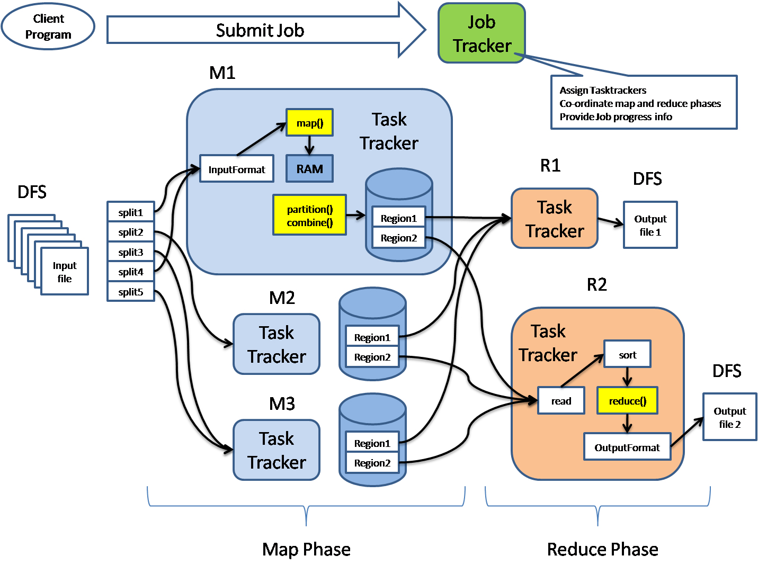
Architecture of Map Reduce-

Slide 6
MapReduce architecture consists of various components.
Job: This is the actual work that needs to be executed or processed
Task: This is a piece of the actual work that needs to be executed or processed. A MapReduce job comprises many small tasks that need to be executed.
Job Tracker: This tracker plays the role of scheduling jobs and tracking all jobs assigned to the task tracker.
Task Tracker: This tracker plays the role of tracking tasks and reporting the status of tasks to the job tracker.
Input data: This is the data used to process in the mapping phase.
Output data: This is the result of mapping and reducing.
Client: This is a program or Application Programming Interface (API) that submits jobs to the MapReduce. MapReduce can accept jobs from many clients.
Hadoop MapReduce Master: This plays the role of dividing jobs into job-parts.
Job-parts: These are sub-jobs that result from the division of the main job.

Slide 7
In the MapReduce architecture, clients submit jobs to the MapReduce Master. This master will then sub-divide the job into equal sub-parts. The job-parts will be used for the two main tasks in MapReduce: mapping and reducing.
The Algorithm-
MapReduce paradigm is based on sending the computer to where the data resides. MapReduce program executes in three stages, namely map stage, shuffle stage, and reduce stage.
Map stage − The map or mapper’s job is to process the input data. Generally, the input data is in the form of file or directory and is stored in the Hadoop file system (HDFS). The input file is passed to the mapper function line by line. The mapper processes the data and creates several small chunks of data.
Reduce stage − This stage is the combination of the Shuffle stage and the Reduce stage. The Reducer’s job is to process the data that comes from the mapper. After processing, it produces a new set of output, which will be stored in the HDFS.

Slide 8
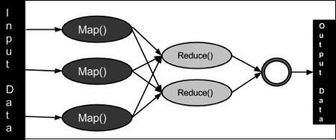
During a MapReduce job, Hadoop sends the Map and Reduce tasks to the appropriate servers in the cluster.
The framework manages all the details of data-passing such as issuing tasks, verifying task completion, and copying data around the cluster between the nodes.
Most of the computing takes place on nodes with data on local disks that reduces the network traffic.
After completion of the given tasks, the cluster collects and reduces the data to form an appropriate result and sends it back to the Hadoop server.

Slide 9
Terminology
PayLoad − Applications implement the Map and the Reduce functions and form the core of the job.
Mapper − Mapper maps the input key/value pairs to a set of intermediate key/value pair.
NamedNode − Node that manages the Hadoop Distributed File System (HDFS).
DataNode − Node where data is presented in advance before any processing takes place.
MasterNode − Node where JobTracker runs, and which accepts job requests from clients.
SlaveNode − Node where Map and Reduce program runs.

Slide 10
JobTracker − Schedules jobs and tracks the assign jobs to Task tracker.
Task Tracker − Tracks the task and reports status to JobTracker.
Job − A program is an execution of a Mapper and Reducer across a dataset.
Task − An execution of a Mapper or a Reducer on a slice of data.
Task Attempt − A particular instance of an attempt to execute a task on a Slave Node.

Slide 11
Phases of MapReduce-
The MapReduce program is executed in three main phases: mapping, shuffling, and reducing. There is also an optional phase known as the combiner phase.
Mapping Phase- This is the first phase of the program. There are two steps in this phase: Splitting, and Mapping.
A dataset is split into equal units called chunks (input splits) in the splitting step. Hadoop consists of a RecordReader that uses TextInputFormat to transform input splits into key-value pairs.
The key-value pairs are then used as inputs in the mapping step. This is the only data format that a mapper can read or understand. The mapping step contains a coding logic that is applied to these data blocks. In this step, the mapper processes the key-value pairs and produces an output of the same form (key-value pairs).

Slide 12
Shuffling phase - This is the second phase that takes place after the completion of the Mapping phase. It consists of two main steps: sorting and merging.
In the sorting step, the key-value pairs are sorted using the keys. Merging ensures that key-value pairs are combined.
The shuffling phase facilitates the removal of duplicate values and the grouping of values. Different values with similar keys are grouped. The output of this phase will be keys and values, just like in the Mapping phase.

Slide 13
Reducer phase- In the reducer phase, the output of the shuffling phase is used as the input.
The reducer processes this input further to reduce the intermediate values into smaller values. It provides a summary of the entire dataset. The output from this phase is stored in the HDFS.
Combiner phase- This is an optional phase that’s used for optimizing the MapReduce process.
It’s used for reducing the pap outputs at the node level. In this phase, duplicate outputs from the map outputs can be combined into a single output. The combiner phase increases speed in the Shuffling phase by improving the performance of Jobs.

Slide 14

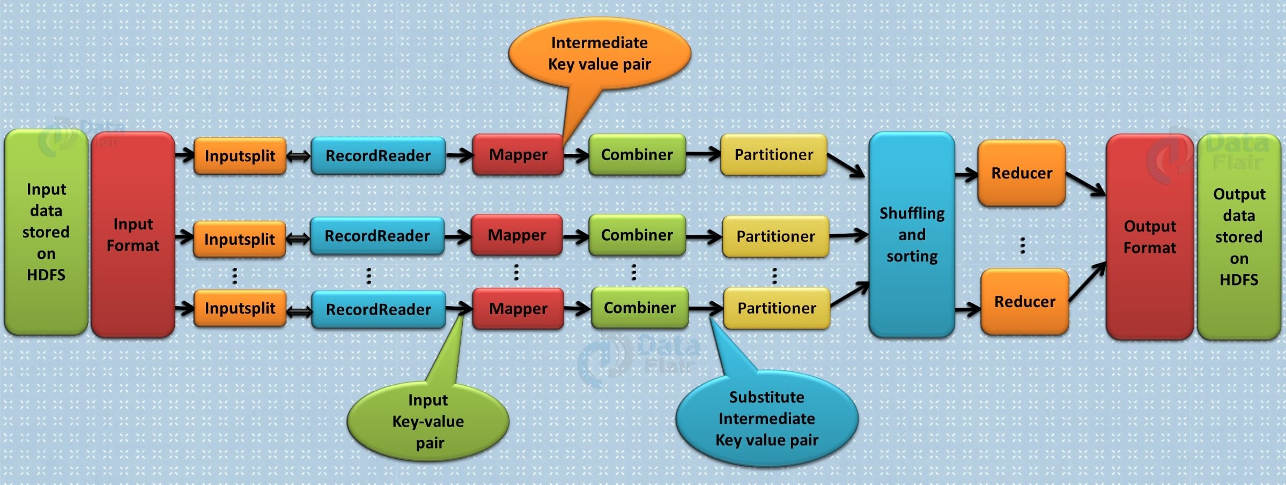

Slide 15
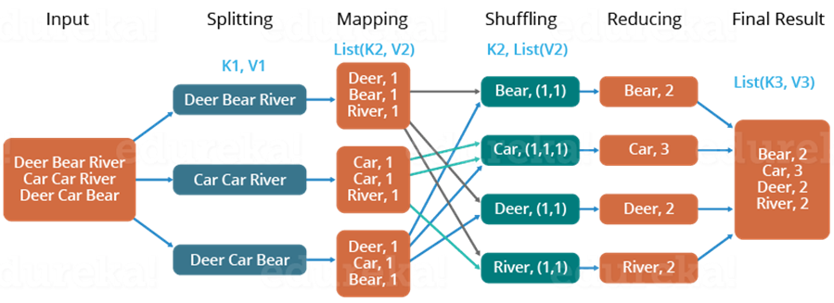

Slide 16
Benefits of Hadoop MapReduce
Speed: MapReduce can process huge unstructured data in a short time.
Fault-tolerance: The MapReduce framework can handle failures.
Cost-effective: Hadoop has a scale-out feature that enables users to process or store data in a cost-effective manner.
Scalability: Hadoop provides a highly scalable framework. MapReduce allows users to run applications from many nodes.
Data availability: Replicas of data are sent to various nodes within the network. This ensures copies of the data are available in the event of failure.
Parallel Processing: In MapReduce, multiple job-parts of the same dataset can be processed in a parallel manner. This reduces the time taken to complete a task.

Slide 17
Applications of MapReduce
The following are some of the practical applications of the MapReduce program.
E-commerce- E-commerce companies such as Walmart, E-Bay, and Amazon use MapReduce to analyze buying behavior. MapReduce provides meaningful information that is used as the basis for developing product recommendations. Some of the information used include site records, e-commerce catalogs, purchase history, and interaction logs.
Social networks- The MapReduce programming tool can evaluate certain information on social media platforms such as Facebook, Twitter, and LinkedIn. It can evaluate important information such as who liked your status and who viewed your profile.
Entertainment- Netflix uses MapReduce to analyze the clicks and logs of online customers. This information helps the company suggest movies based on customers’ interests and behavior.

Slide 18
Map Reduce Program for Weather Dataset
For our example, we will write a program that mines weather data. Weather sensors collecting data every hour at many locations across the globe gather a large volume of log data, which is a good candidate for analysis with MapReduce, since it is semi structured and record-oriented.
Data Format- The data we will use is from the National Climatic Data Center (NCDC, http://www.ncdc.noaa.gov/). The data is stored using a line-oriented ASCII format, in which each line is a record. The format supports a rich set of meteorological elements, many of which are optional or with variable data lengths. For simplicity, we shall focus on the basic elements, such as temperature, which are always present and are of fixed width.

Slide 19
Example shows a sample line with some of the salient fields highlighted. The line has been split into multiple lines to show each field: in the real file, fields are packed into one line with no delimiters. Data files are organized by date and weather station. There is a directory for each year from 1901 to 2001, each containing a zipped file for each weather station with its readings for that year. For example, here are the first entries for 1990:
% ls raw/1990 | head
010010-99999-1990.gz
010014-99999-1990.gz
010015-99999-1990.gz
010016-99999-1990.gz
010017-99999-1990.gz
010030-99999-1990.gz

Slide 20
Analyzing the Data with Hadoop- To take advantage of the parallel processing that Hadoop provides, we need to express our query as a MapReduce job. After some local, small-scale testing, we will be able to run it on a cluster of machines.
Map and Reduce- MapReduce works by breaking the processing into two phases: the map phase and the reduce phase. Each phase has key-value pairs as input and output, the types of which may be chosen by the programmer. The programmer also specifies two functions: the map function and the reduce function.
The input to our map phase is the raw NCDC data. We choose a text input format that gives us each line in the dataset as a text value. The key is the offset of the beginning of the line from the beginning of the file, but as we have no need for this, we ignore it.

Slide 21
Our map function is simple. We pull out the year and the air temperature, since these are the only fields, we are interested in. In this case, the map function is just a data preparation phase, setting up the data in such a way that the reducer function can do its work on it: finding the maximum temperature for each year. The map function is also a good place to drop bad records: here we filter out temperatures that are missing, suspect, or erroneous.
To visualize the way the map works, consider the following sample lines of input data (some unused columns have been dropped to fit the page, indicated by ellipses):
0067011990999991950051507004...9999999N9+00001+99999999999... 0043011990999991950051512004...9999999N9+00221+99999999999...
0043011990999991950051518004...9999999N9-00111+99999999999... 0043012650999991949032412004...0500001N9+01111+99999999999... 0043012650999991949032418004...0500001N9+00781+99999999999...

Slide 22
These lines are presented to the map function as the key-value pairs:
(0, 0067011990999991950051507004...9999999N9+00001+99999999999...)
(106, 0043011990999991950051512004...9999999N9+00221+99999999999...)
(212, 0043011990999991950051518004...9999999N9-00111+99999999999...)
(318, 0043012650999991949032412004...0500001N9+01111+99999999999...)
(424, 0043012650999991949032418004...0500001N9+00781+99999999999...)
The keys are the line offsets within the file, which we ignore in our map function. The map function merely extracts the year and the air temperature (indicated in bold text), and emits them as its output (the temperature values have been interpreted as integers):
(1950, 0)
(1950, 22)
(1950, −11)
(1949, 111)
(1949, 78)

Slide 23
The output from the map function is processed by the MapReduce framework before being sent to the reduce function. This processing sorts and groups the key-value pairs by key. So, continuing the example, our reduce function sees the following input:
(1949, [111, 78])
(1950, [0, 22, −11])
Each year appears with a list of all its air temperature readings. All the reduce function must do now is iterate through the list and pick up the maximum reading:
(1949, 111)
(1950, 22)

Slide 24
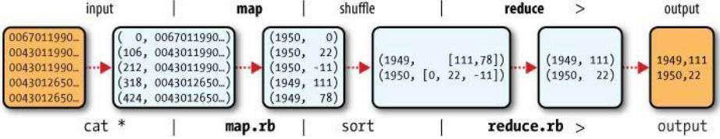
This is the final output: the maximum global temperature recorded in each year. The whole data flow is illustrated in the bellow Figure. At the bottom of the diagram is a Unix pipeline.

Slide 25
Java MapReduce- We need three things:
a map function,
a reduce function, and s
some code to run the job.
The map function is represented by an implementation of the Mapper interface, which declares a map() method.

Slide 26
Example - 1. Mapper for maximum temperature example
import java.io.IOException;
import org.apache.hadoop.io.IntWritable;
import org.apache.hadoop.io.LongWritable;
import org.apache.hadoop.io.Text;
import org.apache.hadoop.mapred.MapReduceBase;
import org.apache.hadoop.mapred.Mapper;
import org.apache.hadoop.mapred.OutputCollector;
import org.apache.hadoop.mapred.Reporter;

Slide 27
public class MaxTemperatureMapper extends MapReduceBase implements Mapper <LongWritable, Text, Text, IntWritable> {
private static final int MISSING = 9999;
public void map(LongWritable key, Text value, OutputCollector<Text, IntWritable> output,
Reporter reporter) throws IOException {
String line = value.toString(); String year = line.substring(15, 19); int airTemperature;
if (line.charAt(87) == '+’) { // parseInt doesn't like leading plus signs airTemperature = Integer.parseInt(line.substring(88, 92)); } else {
airTemperature = Integer.parseInt(line.substring(87, 92)); }
String quality = line.substring(92, 93);
if (airTemperature != MISSING && quality.matches("[01459]")) { output.collect(new Text(year), new IntWritable(airTemperature));
} } }

Slide 28
Example - 2. Reducer for maximum temperature example
import java.io.IOException; import java.util.Iterator;
import org.apache.hadoop.io.IntWritable; import org.apache.hadoop.io.Text;
import org.apache.hadoop.mapred.MapReduceBase;
import org.apache.hadoop.mapred.OutputCollector;
import org.apache.hadoop.mapred.Reducer;
import org.apache.hadoop.mapred.Reporter;

Slide 29
public class MaxTemperatureReducer extends MapReduceBase implements Reducer<Text, IntWritable, Text, IntWritable> {
public void reduce(Text key, Iterator<IntWritable> values,
OutputCollector<Text, IntWritable> output, Reporter reporter) throws IOException
{
int maxValue = Integer.MIN_VALUE; while (values.hasNext()) {
maxValue = Math.max(maxValue, values.next().get()); }
output.collect(key, new IntWritable(maxValue));
} }

Slide 30
Example -3. Application to find the maximum temperature in the weather dataset
import java.io.IOException; import org.apache.hadoop.fs.Path;
import org.apache.hadoop.io.IntWritable; import org.apache.hadoop.io.Text;
import org.apache.hadoop.mapred.FileInputFormat;
import org.apache.hadoop.mapred.FileOutputFormat;
import org.apache.hadoop.mapred.JobClient; import org.apache.hadoop.mapred.JobConf;
public class MaxTemperature {
public static void main(String[] args) throws IOException {
if (args.length != 2) {
System.err.println("Usage: MaxTemperature <input path> <output path>"); System.exit(-1);
}

Slide 31
JobConf conf = new JobConf(MaxTemperature.class);
conf.setJobName("Max temperature");
FileInputFormat.addInputPath(conf, new Path(args[0]));
FileOutputFormat.setOutputPath(conf, new Path(args[1]));
conf.setMapperClass(MaxTemperatureMapper.class);
conf.setReducerClass(MaxTemperatureReducer.class);
conf.setOutputKeyClass(Text.class);
conf.setOutputValueClass(IntWritable.class); JobClient.runJob(conf);
} }

Slide 32
The new Java MapReduce API:
Release 0.20.0 of Hadoop included a new Java MapReduce API, sometimes referred to as “Context Objects,” designed to make the API easier to evolve in the future. The new API is type- incompatible with the old, however, so applications need to be rewritten to take advantage of it. There are several notable differences between the two APIs:
The new API favors abstract classes over interfaces, since these are easier to evolve. For example, you can add a method (with a default implementation) to an abstract class without breaking old implementations of the class. In the new API, the Mapper and Reducer interfaces are now abstract classes.
The new API is in the org.apache.hadoop.mapreduce package (and sub packages). The old API can still be found in org.apache.hadoop.mapred.

Slide 33
The new API makes extensive use of context objects that allow the user code to communicate with the MapReduce system. The MapContext, for example, essentially unifies the role of the JobConf, the OutputCollector, and the Reporter.
• The new API supports both a “push” and a “pull” style of iteration. In both APIs, key- value record pairs are pushed to the mapper, but in addition, the new API allows a mapper to pull records from within the map() method. The same goes for the reducer. An example of how the “pull” style can be useful is processing records in batches, rather than one by one.
Configuration has been unified. The old API has a special JobConf object for job configuration, which is an extension of Hadoop’s vanilla Configuration object. In the new API, this distinction is dropped, so job configuration is done through a Configuration.

Slide 34
Job control is performed through the Job class, rather than JobClient, which no longer exists in the new API.
Output files are named slightly differently: part-m-nnnnn for map outputs, and partr-nnnnn for reduce outputs (where nnnnn is an integer designating the part number, starting from zero).
When converting your Mapper and Reducer classes to the new API, don’t forget to change the signature of the map() and reduce() methods to the new form. Just changing your class to extend the new Mapper or Reducer classes will not produce a compilation error or warning, since these classes provide an identity form of the map() or reduce() method (respectively). Your mapper or reducer code, however, will not be invoked, which can lead to some hard-to-diagnose errors.

Slide 35
Combiner- A Combiner, also known as a semi-reducer, is an optional class that operates by accepting the inputs from the Map class and thereafter passing the output key-value pairs to the Reducer class.
The main function of a Combiner is to summarize the map output records with the same key. The output (key-value collection) of the combiner will be sent over the network to the actual Reducer task as input.
Combiner class- The Combiner class is used in between the Map class and the Reduce class to reduce the volume of data transfer between Map and Reduce. Usually, the output of the map task is large, and the data transferred to the reduce task is high.

Slide 36
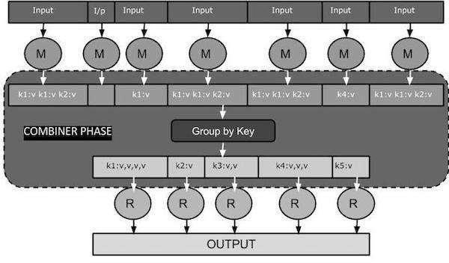
The following MapReduce task diagram shows the COMBINER PHASE.

Slide 37
Here is a brief summary on how MapReduce Combiner works −
A combiner does not have a predefined interface and it must implement the Reducer
interface’s reduce() method.
A combiner operates on each map output key. It must have the same output key-value types as the Reducer class.
A combiner can produce summary information from a large dataset because it replaces the original Map output.
Although, Combiner is optional, yet it helps segregating data into multiple groups for Reduce phase, which makes it easier to process.

Slide 38
MapReduce Combiner Implementation
The following example provides a theoretical idea about combiners. Let us assume we have the following input text file named input.txt for MapReduce.
What do you mean by Object
What do you know about Java
What is Java Virtual Machine
How Java enabled High Performance

Slide 39
The important phases of the MapReduce program with Combiner are:
Record Reader- Record Reader reads every line from the input text file as text and yields output as key-value pairs.
Map Phase- The Map phase takes input from the Record Reader, processes it, and produces the output as another set of key-value pairs.
Combiner Phase- The Combiner phase takes each key-value pair from the Map phase, processes it, and produces the output as key-value collection pairs.

Slide 40
Partitioner Phase- The partitioning phase takes place after the map phase and before the reduce phase. The number of partitions is equal to the number of reducers. The data gets partitioned across the reducers according to the partitioning function.
Reducer Phase- The Reducer phase takes each key-value collection pair from the Combiner phase, processes it, and passes the output as key-value pairs. Note that the Combiner functionality is same as the Reducer.
Record Writer- This is the last phase of MapReduce where the Record Writer writes every key-value pair from the Reducer phase and sends the output as text.

Slide 41
